Slide 1
FILE HANDLING IN PYTHON

Slide 2
Introduction
FILE HANDLING is a mechanism by which we can read data of disk files in python program or write back data from python program to disk files.
So far in our python program the standard input in coming from keyboard an output is going to monitor i.e. where data is stored permanent and entered data is present as long as program is running BUT file handling allows us to store data entered through python program permanently in disk file and later on we can read back the data

Slide 3
DATA FILES
It contains data pertaining to a specific application, for later use. The data files can be stored in two ways –
Text File
Binary File

Slide 4
Text File
Text file stores information in ASCII OR UNICODE character. In text file everything will be stored as a character for example if data is “computer” then it will take 8 bytes and if the data is floating value like 11237.9876 it will take 10 bytes.
In text file each like is terminated by special character called EOL. In text file some translation takes place when this EOL character is read or written. In python EOL is ‘\n’ or ‘\r’ or combination of both

Slide 5
Binary files
It stores the information in the same format as in the memory i.e. data is stored according to its data type so no translation occurs.
In binary file there is no delimiter for a new line
Binary files are faster and easier for a program to read and write than text files.
Data in binary files cannot be directly read, it can be read only through python program for the same.

Slide 6
Steps in Data File Handling
OPENING FILE
We should first open the file for read or write by specifying the name of file and mode.
PERFORMING READ/WRITE
Once the file is opened now we can either read or write for which file is opened using various functions available
CLOSING FILE
After performing operation we must close the file and release the file for other application to use it,

Slide 7
Opening File
File can be opened for either – read, write, append.
SYNTAX:
file_object = open(filename)
Or
file_object = open(filename,mode)
** default mode is “read”

Slide 8
Opening File
myfile = open(“story.txt”)
here disk file “story.txt” is loaded in memory and its reference is linked to “myfile” object, now python program will access “story.txt” through “myfile” object.
here “story.txt” is present in the same folder where .py file is stored otherwise if disk file to work is in another folder we have to give full path.

Slide 9
Opening File
myfile = open(“article.txt”,”r”)
here “r” is for read (although it is by default, other
options are “w” for write, “a” for append)
myfile = open(“d:\\mydata\\poem.txt”,”r”)
here we are accessing “poem.txt” file stored in
separate location i.e. d:\mydata folder.
at the time of giving path of file we must use double backslash(\\) in place of single backslash because in python single slash is used for escape character and it may cause problem like if the folder name is “nitin” and we provide path as d:\nitin\poem.txt then in \nitin “\n” will become escape character for new line, SO ALWAYS USE DOUBLE BACKSLASH IN PATH

Slide 10
Opening File
myfile = open(“d:\\mydata\\poem.txt”,”r”)
another solution of double backslash is using “r” before the path making the string as raw string i.e. no special meaning attached to any character as:
myfile = open(r“d:\mydata\poem.txt”,”r”)

Slide 11
File Handle
myfile = open(r“d:\mydata\poem.txt”,”r”)
In the above example “myfile” is the file object or file handle or file pointer holding the reference of disk file. In python we will access and manipulate the disk file through this file handle only.

Slide 12
File Access Mode
Text File Mode | Binary File Mode | Description | Notes
‘r’ | ‘rb’ | Read only | File must exists, otherwise Python raises I/O errors
‘w’ | ‘wb’ | Write only | If file not exists, file is created If file exists, python will truncate existing data and overwrite the file.
‘a’ | ‘ab’ | Append | File is in write mode only, new data will be added to the end of existing data i.e. no overwriting. If file not exists it is created
‘r+’ | ‘r+b’ or ‘rb+’ | Read and write | File must exists otherwise error is raised Both reading and writing can take place
w+ | ‘w+b’ or ‘wb+’ | Write and read | File is created if not exists, if exists data will be truncated, both read and write allowed
‘a+’ | ‘a+b’ or ‘ab+’ | Append with Write and read | Same as above but previous content will be retained and both read and write.

Slide 13
Closing file
As reference of disk file is stored in file handle so to close we must call the close() function through the file handle and release the file.
myfile.close()
Note: open function is built-in function used standalone while close() must be called through file handle

Slide 14
Reading from File
To read from file python provide many functions like :
Filehandle.read([n]) : reads and return n bytes, if n is not specified it reads entire file.
Filehandle.readline([n]) : reads a line of input. If n is specified reads at most n bytes.
Filehandle.readlines(): reads all lines and returns them in a list

Slide 15


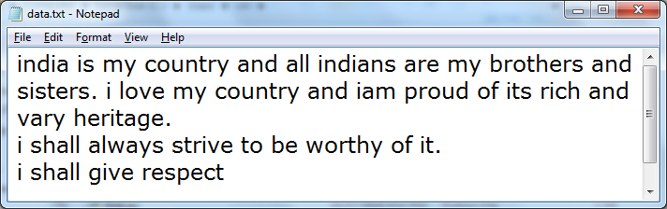
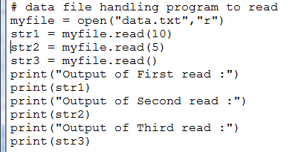
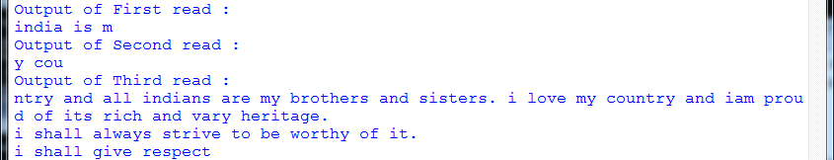
Example-1: read()
SAMPLE FILE

Slide 16

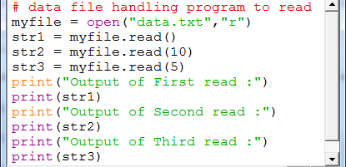
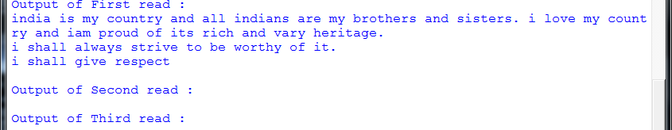
Example-2: read()
SAMPLE FILE

Slide 17

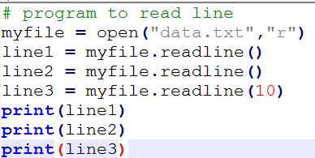
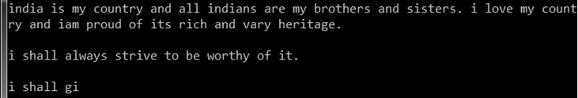
Example-3: readline()
SAMPLE FILE

Slide 18

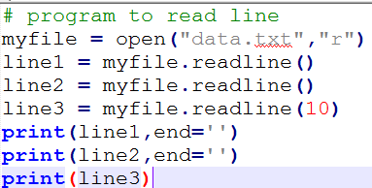
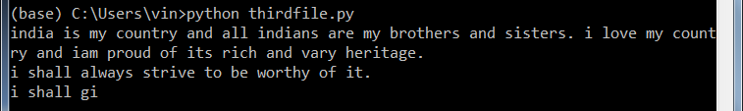
Example-3: readline()
SAMPLE FILE
HAVE YOU NOTICED THE DIFFERENCE IN OUTPUT FROM PREVIOUS OUPUT?

Slide 19
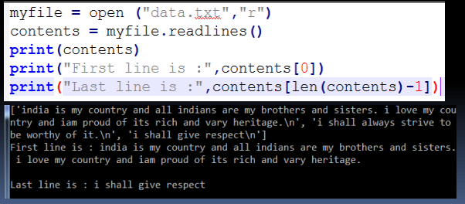
Example-4: readlines()
SAMPLE FILE

Slide 20
Writing onto files
After read operation, let us take an example of how to write data in disk files. Python provides functions:
write ()
writelines()
The above functions are called by the file handle to write desired content.
Name | Syntax | Description
write() | Filehandle.write(str1) | Writes string str1 to file referenced by filehandle
Writelines() | Filehandle.writelines(L) | Writes all string in List L as lines to file referenced by filehandle.

Slide 21
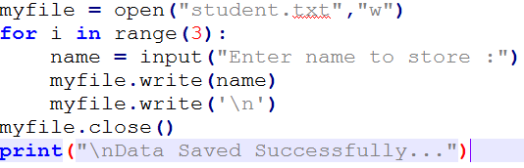
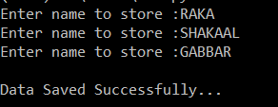
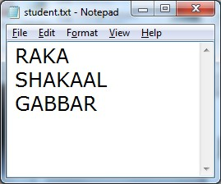
Example-1: write using “w” mode

Slide 22
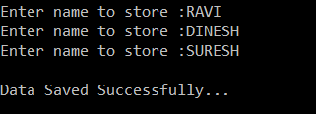
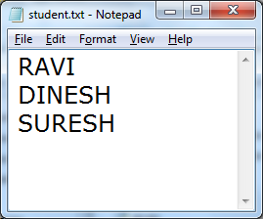
Example-1: write using “w” mode
Now we can observe that while writing data to file using “w” mode the previous content of existing file will be overwritten and new content will be saved.
If we want to add new data without overwriting the previous content then we should write using “a” mode i.e. append mode.

Slide 23
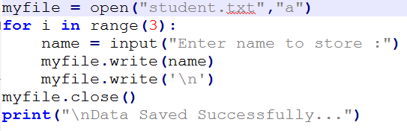
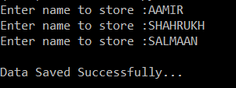
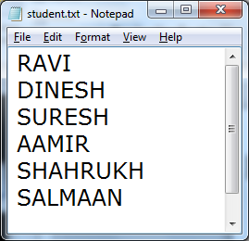
Example-1: write using “a” mode
New content is added after previous content

Slide 24
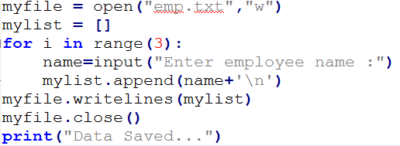

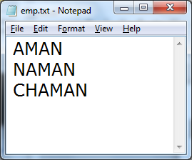
Example-2:
using writelines()

Slide 25
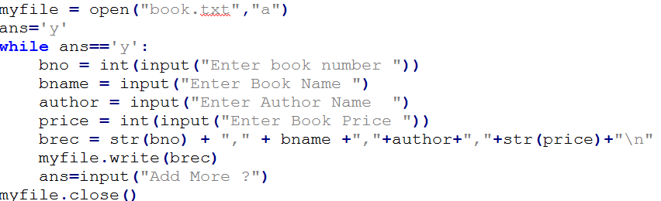
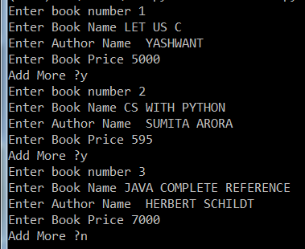
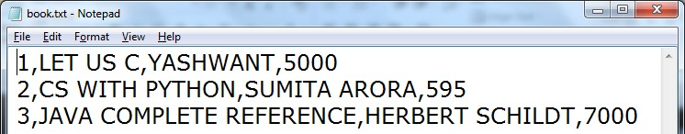
Example-3: writing string as a record to file

Slide 26
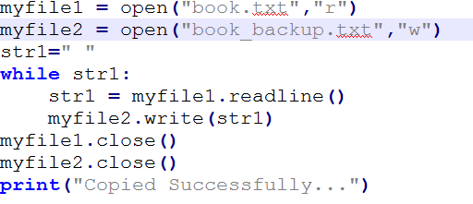

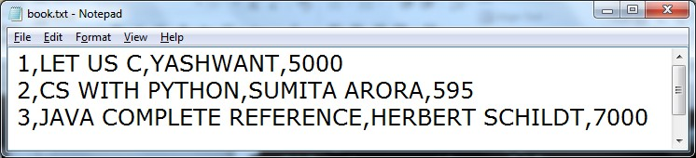
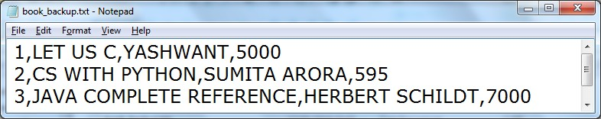
Example-3: to copy the content of one file to another file

Slide 27
Removing whitespaces after reading the file
read() and readline() reads data from file and return it in the form of string and readlines() returns data in the form of list.
All these read function also read leading and trailing whitespaces, new line characters. If you want to remove these characters you can use functions
strip() : removes the given character from both ends.
lstrip(): removes given character from left end
rstrip(): removes given character from right end

Slide 28
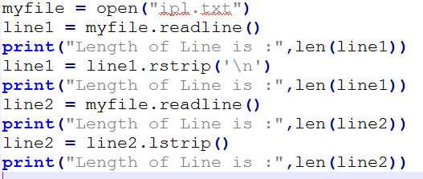


Example: strip(),lstrip(), rstrip()

Slide 29
Standard input, output and error stream
Standard Input : Keyboard
Standard Output
Standard error
: Monitor
: Monitor
Standard Input devices(stdin) reads from keyboard
Standard output devices(stdout) display output on monitor
Standard error devices(stderr) same as stdout but normally for errors only.

Slide 30
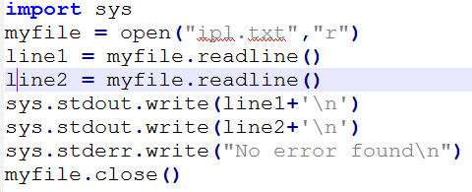

Standard input, output and error stream
The standard devices are implemented as files called standard streams in Python and we can use them by using sys module.
After importing sys module we can use standard streams stdin, stdout, stderr

Slide 31
Binary file operations
If we want to write a structure such as list or dictionary to a file and read it subsequently we need to use the Python module pickle. Pickling is the process of converting structure to a byte stream before writing to a file and while reading the content of file a reverse process called Unpickling is used to convert the byte stream back to the original format.

Slide 32
Steps to perform binary file operations
First we need to import the module called pickle.
This module provides 2 main functions:
dump() : to write the object in file which is loaded in binary mode
Syntax : dump(object_to_write, filehandle)
load() : dumped data can be read from file using load() i.e. it is used to read object from pickle file.
Syntax: object = load(filehandle)

Slide 33
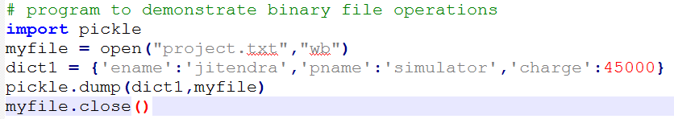
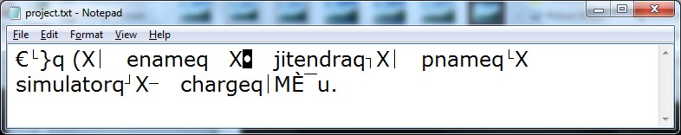
Example: dump()
See the content is some kind of encrypted format, and it is not in complete readable
form

Slide 34

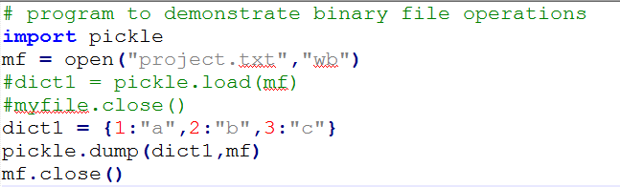
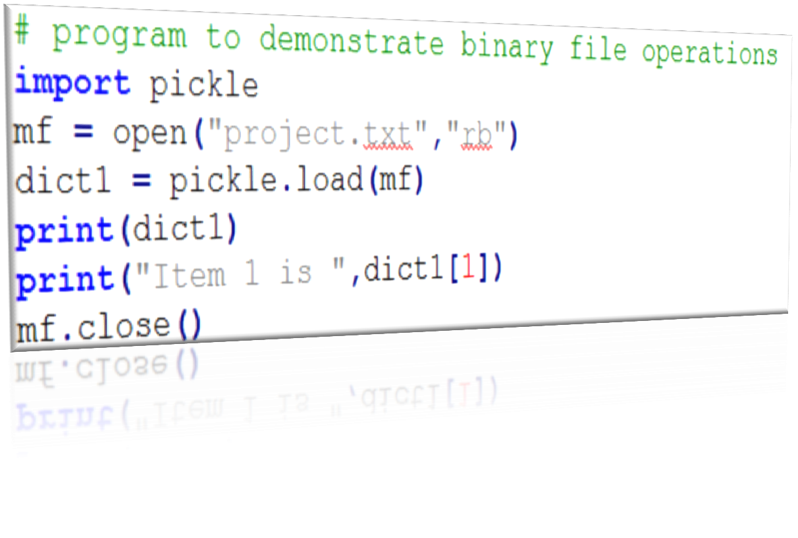

Example: load()

